Slide 1
RURAL WATER SUPPLY AND SANITATION SYSTEM
Rollno | Name
CB.EN.U4CSE18212 | V Ashwin
CB.EN.U4CSE18227 | G Sri Ram
CB.EN.U4CSE18234 | K Chandramohan Reddy
CB.EN.U4CSE18266 | N Venkatasubramanian
Section: C Faculty in Charge: Ms. Bindu K R

Slide 2
Overview
Introduction
Abstract
Logical Database Design ER Diagram
Entities
Attributes
Relationships
Enhanced ER Diagram
ER to Relational Schema Mapping
User Interface Screens
References

Slide 3
Overview
Normalization
Dependency Diagram
Lossless Decomposition Check
SQL Commands for insertion and deletion
Connectivity Code
UI Screens
Conclusion
References

Slide 4
Introduction
The Failure of Rural Communities to understand the need for water resources as a social good and their inability to adhere to hygienic sanitation practices has led to the improper usage of water resources. There is also an acute need for a proper and easy to use health and sanitation system in rural areas. This makes the aim of the project to focus on four different components.
Improved Water Supply Facilities.
Hygienic Sanitation System.
Community Mobilisation and Education.
Advanced Monitoring, Evaluating, and Supporting System.

Slide 5
Abstract
Starting with the first component, water for the village is considered as a single resource and is distributed equally among the villagers in appropriate time intervals. We also have a reserve to be used in the case of an emergency.
The second component targets on the sanitary investments like constructing safe wastewater and excreta disposal systems, public installations of latrines on a pilot basis, small sewer collectors, community septic tanks, and lagoon-type wastewater treatment plant.
The third component focuses on educating the villagers by connecting with them in a way they understand using community mobilization.
The last and important component focuses on using the latest and advanced technology to monitor the whole system in real-time and evaluate the efficiency of both the villagers and the system in frequent time intervals. This whole data is stored in a relational database and can be used anytime to keep track of the progress of the project and gauge the success of this project especially in the area of funding.

Slide 6
Abstract
Eventually, this project will ensure that the villagers are benefitted by the implementation of a proper water resource management system along with a hygienic sanitation system and are educated regarding the usage of the same. The monitoring system built will be used to keep track of the efficiency of the system and the project as a whole.

Slide 7
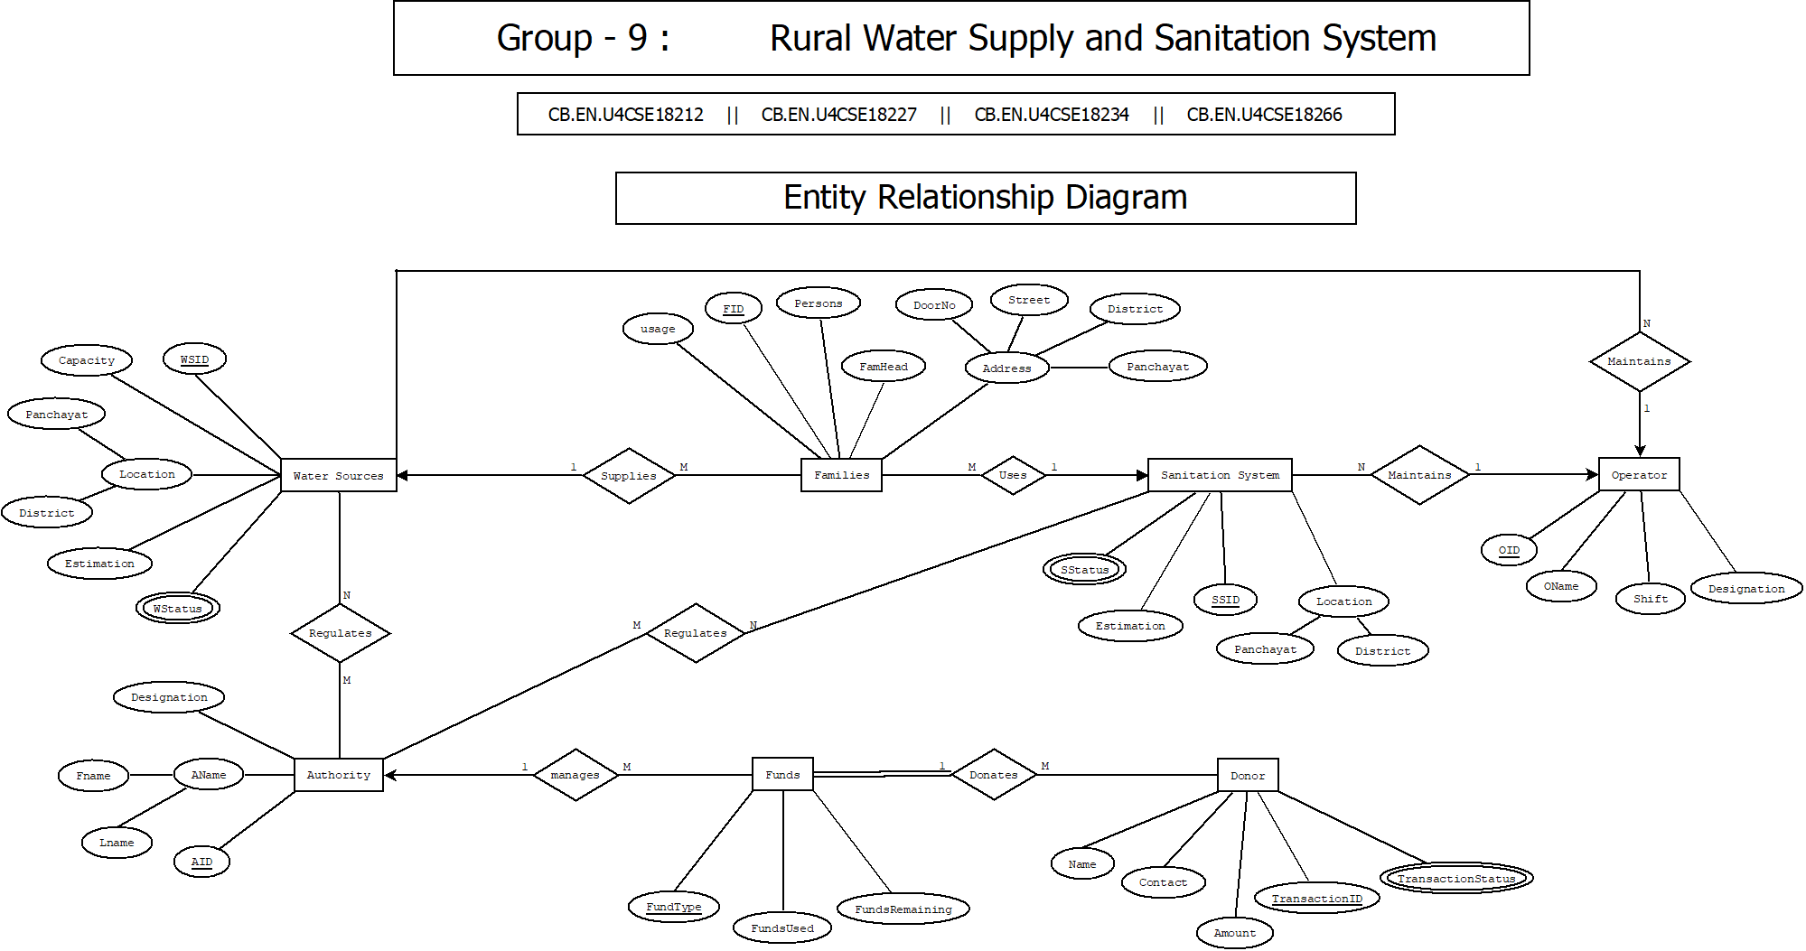
ER Diagram

Slide 8
ER diagram -Entities
Water Source
Sanitation System
Employee
Authority
Operator
Families
Donor
Funds

Slide 9
ER diagram - Attributes
1. Water Sources
WSID – Primary Key
Location
Capacity
Estimation
WStatus

Slide 10
ER diagram - Attributes
2. Sanitation System
SSID – Primary Key
Location
Estimation
SStatus

Slide 11
ER diagram - Attributes
3. Employee
EmpID – Primary Key
EName
ContactNumber
Role

Slide 12
ER diagram - Attributes
4. Authority
EmpID – Primary Key
EName
ContactNumber
Role

Slide 13
ER diagram - Attributes
5. Operator
OID – Primary Key
OName
Shift
Designation

Slide 14
ER diagram - Attributes
6. Families
FID – Primary Key
Persons
FamHead
Pincode

Slide 15
ER diagram - Attributes
7. Funds
FundType – Primary Key
FundsUsed
FundsRemaining

Slide 16
ER diagram - Attributes
8. Donor
TransactionID – Primary Key
Name
Contact
TransactionStatus

Slide 17
ER diagram -Relationships
1. Water Sources SUPPLIES Families
2. Authority REGULATES Water Sources
3. Authority REGULATES Sanitation Systems
4. Authority MANAGES Funds
5. Authority IS-A Employee

Slide 18
ER diagram - Relationships
6. Operator IS-A Employee
7. Operator MAINTAINS Water Sources
8. Operator MAINTAINS Sanitation System
9. Families USES Sanitation System
10. Donor DONATES Funds

Slide 19
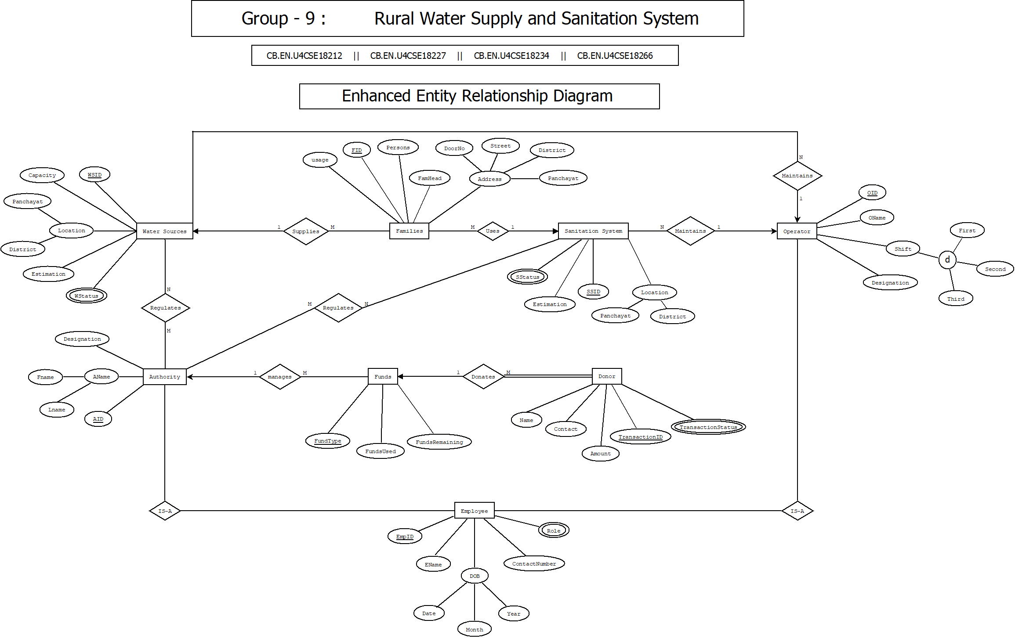
Enhanced ER Diagram

Slide 20
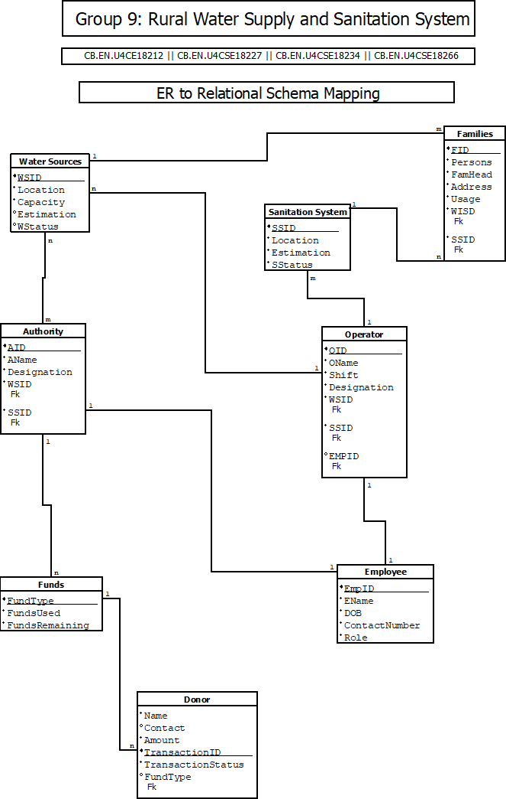
ER to Relational schema mapping

Slide 21

User interface screens - Home screen

Slide 22
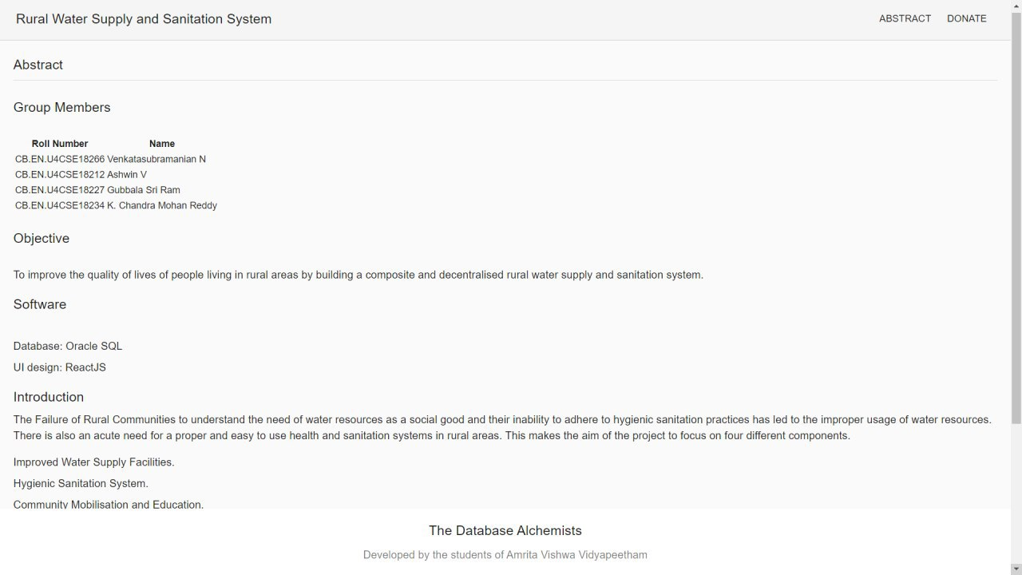
User interface screens - Abstract page

Slide 23
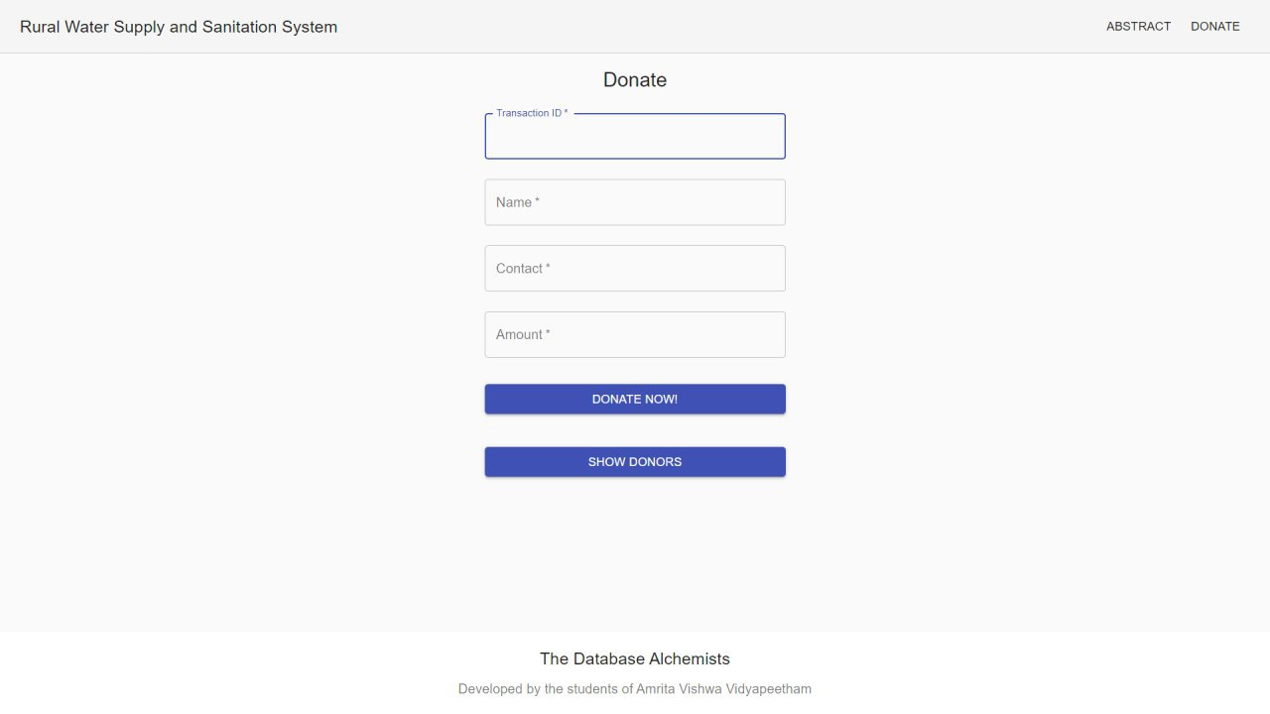
User Interface Screens - Donation form

Slide 24
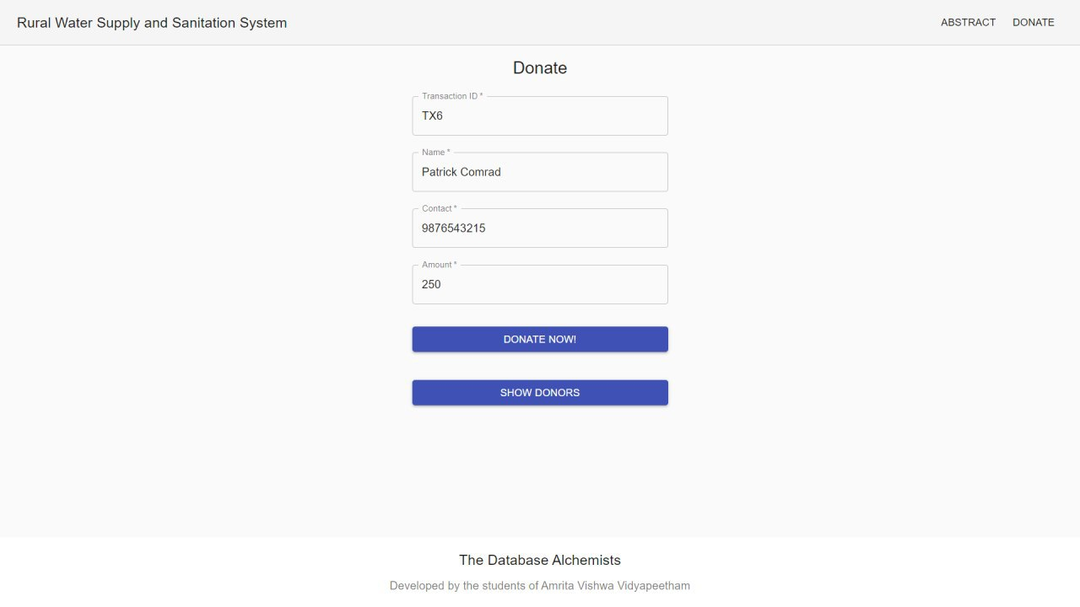
User Interface Screens - Donation form

Slide 25
User Interface Screens - Donar table

Slide 26
Overview
Normalization
Creation of Tables
User Interface Screens
References

Slide 27
Initial Water_Supply_and_Sanitation Table
Water_Supply_and_Sanitation (Pincode, Panchayat, District, EmpID, FName, LName, EContact, JobCode, Designation, Shift, WSID, WStatus, WCapacity, WEstimation, Month, Year, Usage, SSID, SStatus, SEstimation, FID, Persons, FHead, Consumption, FContact, TransactionID, AccountNumber, Amount, DDate, ExpenseID, EDate, EAmount)

Slide 28
Functional Dependencies
Pincode -> Panchayat, District
EmpID -> EContact, LName, FName, JobCode
JobCode -> Designation, Shift
WSID -> WEstimation, WCapacity, WStatus, Pincode
WSID, Month, Year -> Usage
SSID -> SEstimation, SStatus, Pincode
FID -> FContact, Consumption, FHead, Persons, Pincode
TransactionID -> Amount, AccountNumber, DDate, DContact
ExpenseID -> EDate, EAmount, EMPID, WSID, SSID

Slide 29

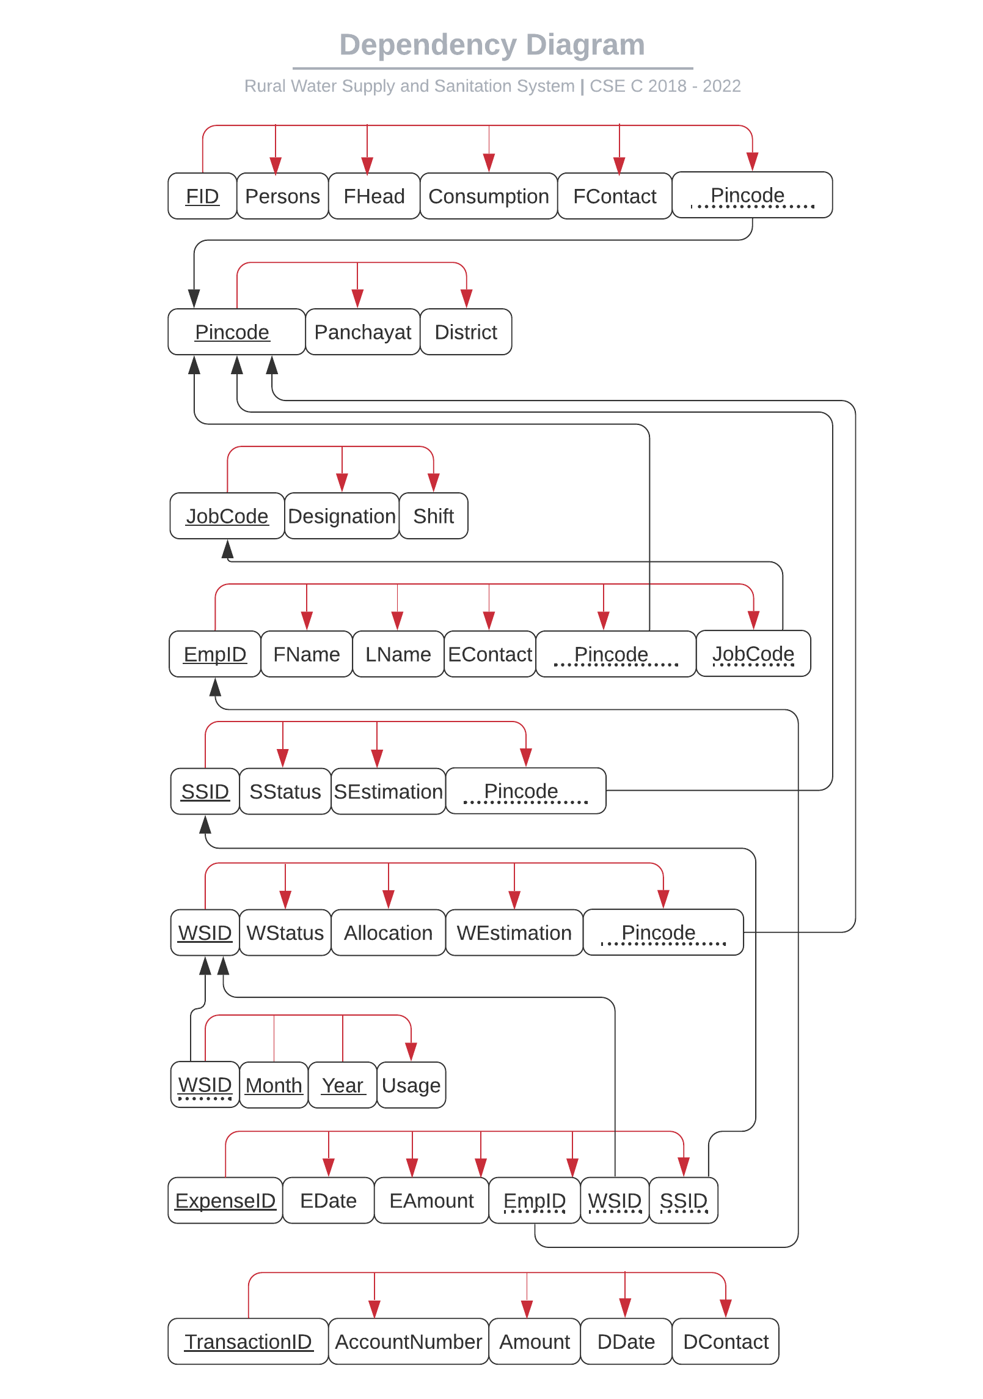
Dependency Diagram of Normalized Schema

Slide 30
Functional Dependency Closure
{Pincode}+ = {Panchayat, District}
{Panchayat}+ = {Panchayat}
{District}+ = {District}

Slide 31
Functional Dependency Closure
{EmpID}+ = {EmpID, FName, LName, EContact, JobCode, Pincode, Panchayat, District}
{FName}+ = {FName}
{LName}+ = {LName}
{EContact}+ = {EContact}

Slide 32
Functional Dependency Closure
{JobCode}+ = {JobCode, Designation, Shift}
{Designation}+ = {Designation}
{Shift}+ = {Shift}

Slide 33
Functional Dependency Closure
{WSID}+ = {WSID, WEstimation, WStatus, WCapacity, Pincode, Panchayat, District}
{WStatus}+ = {WStatus}
{WCapacity}+ = {WCapacity}
{WEstimation}+ = {WEstimation}

Slide 34
Functional Dependency Closure
{WSID, Month, Year} + = {WSID, WEstimation, WCapacity, WStatus, Pincode, Panchayat, District ,Month, Year, Usage}
{Month}+ = {Month}
{Year}+ = {Year}
{Usage}+ = {Usage}

Slide 35
Functional Dependency Closure
{SSID}+ = {SSID, SEstimation, SStatus, Pincode, Panchayat, District}
{SStatus}+ = {SStatus}
{SEstimation}+ = {SEstimation}

Slide 36
Functional Dependency Closure
{FID}+ = {FID, FContact, Consumption, FHead, Persons, Pincode, Panchayat, District}
{Persons}+ = {Persons}
{FHead}+ = {FHead}
{Consumption}+ = {Consumption}
{FContact}+ = {FContact}

Slide 37
Functional Dependency Closure
{TransactionID}+ = {TransactionID, Amount, AccountNumber, DDate, DContact}
{AccountNumber}+ = {AccountNumber}
{Amount}+ = {Amount}
{DDate}+ = {DDate}
{DContact}+ = {DContact}

Slide 38
Functional Dependency Closure
{ExpenseID}+ = {ExpenseID, EDate, EAmount}
{EDate}+ = {EDate}
{EAmount}+ = {EAmount}

Slide 39
Attribute Closure
{Pincode}+ = {Pincode, Panchayat, District}
{JobCode}+ = {Designation, Shift}
{EmpID}+ = {EmpID, EContact, LName, FName, Pincode, Panchayat, District}
{WSID}+ = {WSID, WEstimation, Capacity, WStatus, Pincode, Panchayat, District}
{WSID, Month, Year} + = {WSID, WEstimation, WCapacity, WStatus, Pincode, Panchayat, District , Month, Year, Usage}

Slide 40
Attribute Closure
{SSID}+ = {SSID, SEstimation, SStatus, Pincode, Panchayat, District}
{FID}+ = {FID, FContact, Consumption, FHead, Persons, Pincode, Panchayat, District}
{TransactionID}+ = {TransactionID , Amount, AccountNumber, DDate, DContact}
{ExpenseID}+ = {ExpenseID, EDate, EAmount, EMPID, WSID, SSID}

Slide 41
Canonical cover
EmpID -> FName
EmpID -> EName
EmpID -> EContact
EmpID -> JobCode
EmpID -> Pincode

Slide 42
Canonical cover
JobCode -> Designation
JobCode -> Shift
WSID -> WStatus
WSID -> WCapacity
WSID -> WEstimation
WSID -> Pincode

Slide 43
Canonical cover
SSID -> Pincode
SSID -> SEstimation
SSID -> SStatus

Slide 44
Canonical cover
FID -> Persons
FID -> FHead
FID -> Consumption
FID -> FContact
FID -> Pincode
WSID Month Year -> Usage

Slide 45
Canonical cover
ExpenseID -> EDate
ExpenseID -> EAmount
ExpenseID -> WSID
ExpenseID -> EmpID
ExpenseID -> SSID
ExpenseID -> DContact

Slide 46
Canonical cover
TransactionID -> AccountNumber
TransactionID -> Amount
TransactionID -> DDate
Pincode -> Panchayat
Pincode -> District

Slide 47
Super Keys
Pincode, EmpID, WSID, Month, Year, SSID, FID, ExpenseID, TransactionID

Slide 48
Anomalies
In Employee Table, Shift depends on Designation which is not a primary key.
This brought in partial dependency which created creation, updation and deletion anomalies.
We resolved this by decomposing those attributes to a new Jobs Table which acted as a foreign key in the Employee Table.

Slide 49
Conditions for 1NF
Each table should have a primary key.
The values in each column of a table should be atomic.
There should not be any repeating groups

Slide 50
Conditions satisfied and violated by the relation Water_Supply_And_Sanitation_System
Composite Primary Key is present
There are non-atomic values present in the relation.
a. There can be more than one EmpID, WSID and SSID mapped to one Pincode.
b. There is a many to many relation present here.
There are no repeating groups.

Slide 51
Solution
To reduce the table into 1NF, we make the values atomic by splitting them into different tuples in the same relations.

Slide 52
Conditions for 2NF
The relation must be in 1NF
All non-key attributes are fully functionally dependent on the primary key.

Slide 53
Dependencies
Pincode ->Panchayat, District
EmpID ->EContact, LName, FName, JobCode
JobCode -> Designation, Shift
WSID -> WEstimation, WCapacity, WStatus, Pincode
WSIDMonth, Year ->Usage

Slide 54
Dependencies
SSID ->SEstimation, SStatus, Pincode
FID -> FContact, Consumption, FHead, Persons, Pincode
TransactionID -> Amount, AccountNumber, DDate
ExpenseID -> EDate, EAmount, EMPID, WSID, SSID

Slide 55
Solution
Decompose the relations based on their partial dependencies

Slide 56
Decomposed Relations
Location - (Pincode, WSID, SSID, EmpID, FID, Panchayat, District)
Employee - (EmpID, FName, LName, EContact, JobCode, Pincode, Designation, Shift)
Water Sources - (WSID, WStatus, WCapacity, WEstimation, Pincode )
WaterUsage - (WSID, Month, Year, Usage)

Slide 57
Decomposed Relations
Sanitation Systems - (SSID, SStatus, SEstimation, Pincode )
Families - (FID, Persons, FHead, Consumption, FContact, Pincode)
Donation - ( TransactionID, AccountNumber, Amount, DDate )
Expenditure - ( ExpenseID, EDate, EmpID, WSID, SSID, EAmount )

Slide 58
Conditions for 3NF
The relation must be in 2NF
No non-key attribute should be transitively dependent on the primary key

Slide 59
Transitive Dependencies
EmpID -> EContact, LName, FName, JobCode
JobCode -> Designation, Shift

Slide 60
Solution
The transitive dependencies have been normalized by decomposing the relations into the following relations
Employee - (EmpID, FName, LName, EContact, JobCode, Pincode)
Job - ( JobCode, Designation, Shift )

Slide 61
Checking for BCNF
All the relations after being normalized to 3NF are present in BCNF as there are no non-key attribute determining is determining a key attribute.

Slide 62
Chase Method on Employee
Chase method is performed over the relation Employee after the transitive dependency is being resolved to check whether the decomposition is lossless

Slide 63
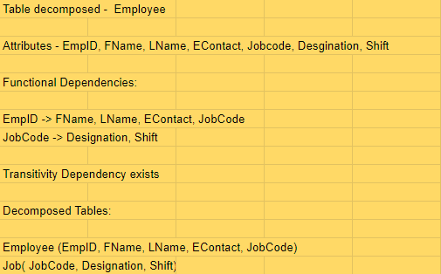
Attributes and dependency in Employee

Slide 64
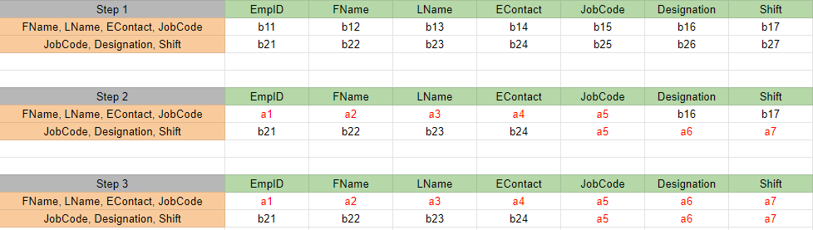
Chase method performed on Employee

Slide 65
Result
From the chase method performed over the relation employee we have found out the all attributes can be determined from the given functional dependencies and given decomposition.

Slide 66
Chase Method on Water Source
Chase method is performed over the relation WaterSource which has partial dependency which is being resolved to check whether the decomposition is lossless.

Slide 67
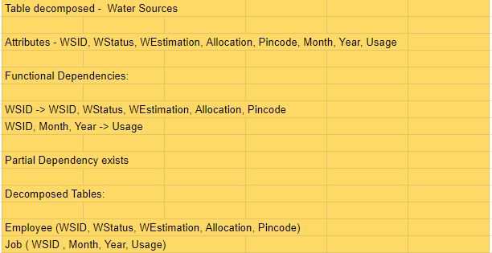
Attributes and dependency in Employee

Slide 68
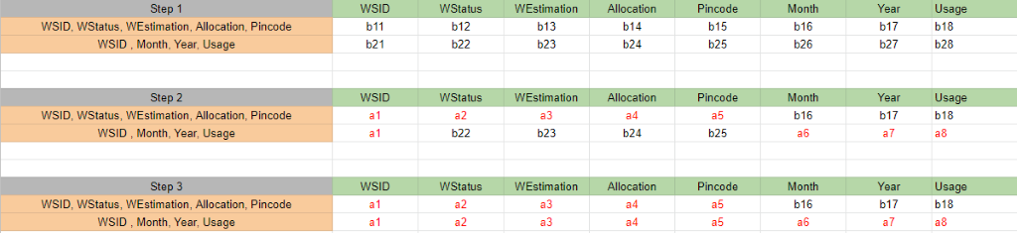
Chase method performed on Employee

Slide 69
Result
From the chase method performed over the relation WaterSource we have found out the all attributes can be determined from the given functional dependencies and given decomposition.

Slide 70
Dependency preserving
All the below listed dependencies have can be found in the decomposed tables as shown in the functional dependency diagram. Hence dependency is preserved.

Slide 71
Dependencies
Pincode ->Panchayat, District
EmpID -> EContact, LName, FName, JobCode
JobCode ->Designation, Shift
WSID ->WEstimation, WCapacity, WStatus, Pincode

Slide 72
Dependencies
WSID ->Month, Year Usage
SSID ->SEstimation, SStatus, Pincode
FID ->FContact, Consumption, FHead, Persons, Pincode
TransactionID ->Amount, AccountNumber, DDate
ExpenseID ->EDate, EAmount, EMPID, WSID, SSID

Slide 73
Final schema
Location - (Pincode, WSID, SSID, EmpID, FID, Panchayat, District)
Employee - (EmpID, FName, LName, EContact, JobCode, Pincode)
Job - ( JobCode, Designation, Shift )
Water Sources - (WSID, WStatus, WCapacity, WEstimation, Pincode )

Slide 74
Final Schema
WaterUsage - ( WSID, Month, Year, Usage)
Sanitation Systems - (SSID, SStatus, SEstimation, Pincode )
Families - ( FID, Persons, FHead, Consumption, FContact, Pincode)
Donation - ( TransactionID, AccountNumber, Amount, DDate )
Expenditure - ( ExpenseID, EDate, EmpID, WSID, SSID, EAmount )

Slide 75
Creation of LocationTable
create table Location
(
Pincode number(6) not null,
Panchayat varchar2(15),
District varchar2(20),
constraint pk_Pincode primary key (Pincode)
)

Slide 76
Insertion Of LocationTable
insert into Location values(641112,'Ettimadai','Coimbatore');
insert into Location values(641105,'Madukarai','Coimbatore');
insert into Location values(641041,'PN Pudur','Coimbatore');
insert into Location values(641062,'RG Pudur','Coimbatore');
insert into Location values(635602,'Adiyur','Vellore');
insert into Location values(641605,'Ugayanur','Tiruppur');
insert into Location values(609503,'Koothanur','Tiruppur');
insert into Location values(621702,'Ambil','Tiruchirappalli');
insert into Location values(626126,'Kunnur','Theni');
insert into Location values(641655,'Alathur','Coimbatore');

Slide 77
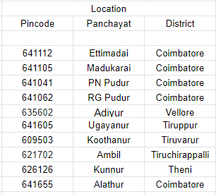
Sample Data
LocationTable

Slide 78
Creation of JobTable
create table Job
(
JobCode varchar2(3) not null,
Designation varchar2(20),
Shift varchar2(15),
constraint pk_JobCode primary key (JobCode)
)

Slide 79
Insertion Of JobTable
insert into Job values('J01','Admin','Full-time');
insert into Job values('J02','Planning Engineer','Full-time');
insert into Job values('J03','Project Manager','Full-time');
insert into Job values('J04','Accountant','Full-time');
insert into Job values('J05','Electrician','Morning');
insert into Job values('J06','Electrician','Evening');
insert into Job values('J07','Electrician','Night');
insert into Job values('J08','Plumber','Morning');
insert into Job values('J09','Plumber','Evening');
insert into Job values('J10','Pumber','Night');
insert into Job values('J11','House Keeping','Morning');
insert into Job values('J12','House Keeping','Evening');
insert into Job values('J13','House Keeping','Night');

Slide 80
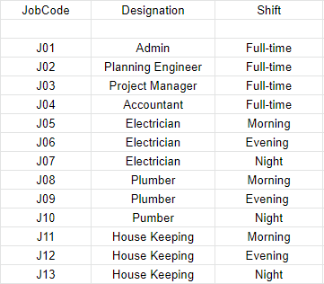
Sample Data
Job Table

Slide 81
Creation of EmployeeTable
create table Employee (
EmpID varchar2(4) not null,
FName varchar2(20),
LName varchar2(20),
EContact number(10),
JobCode varchar2(3),
Pincode number(6),
constraint pk_EmpID primary key (EmpID),
constraint fk_JobCode FOREIGN KEY(JobCode) REFERENCES Job(JobCode),
constraint fk_Pincode FOREIGN KEY(Pincode) REFERENCES Location(Pincode)
)

Slide 82
Insertion Of EmployeeTable
insert into Employee values('E001','Ashwin','Venkatesan',9867564361,'J01',641105);
insert into Employee values('E002','Senthi','kumar',8985663421,'J05',641041);
insert into Employee values('E003','Ganesh','Iyer',9676415267,'J07',641062);
insert into Employee values('E004','Suresh','Nair',9989432678,'J04',635602);
insert into Employee values('E005','Rama','Rao',8884587239,'J06',641605);
insert into Employee values('E006','Ashwin','Raman',9876523465,'J02',609503);
insert into Employee values('E007','Ramachandra','Iyer',9987643257,'J08',641112);
insert into Employee values('E008','Deva','Pillai',9876345656,'J04',621702);
insert into Employee values('E009','Dharun','Venkatesah',6308456579,'J03',626126);
insert into Employee values('E0010','Kavin','Thevar',9441343733,'J09',641655);

Slide 83
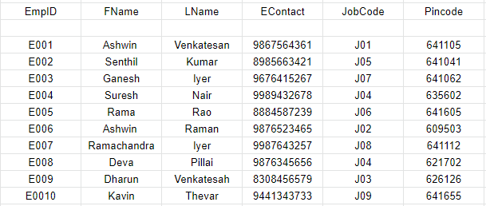
Sample Data
Employee Table

Slide 84
Creation of WaterSourceTable
create table WaterSource
(
WSID varchar2(4) not null,
WStatus varchar2(15),
WEstimation number(7),
WCapacity number(6),
Pincode number(6),
constraint pk_WSID primary key (WSID),
constraint fk_WPincode FOREIGN KEY(Pincode) REFERENCES Location(Pincode)
)

Slide 85
Insertion Of WaterSourceTable
insert into WaterSource values('W002','Constructed',5261510,120000,641041);
insert into WaterSource values('W003','Constructed',4500000,55000,641062);
insert into WaterSource values('W005','Constructed',5400000,75000,641605);
insert into WaterSource values('W007','Constructed',7500000,150000,641112);
insert into WaterSource values('W008','Constructed',7000000,135000,621702);

Slide 86
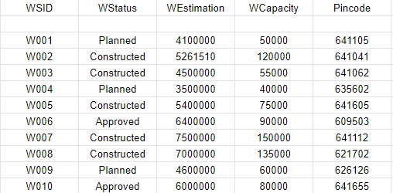
Sample Data
WaterSource Table

Slide 87
Creation of WaterUsage Table
create table WaterUsage
(
WSID varchar2(4) not null,
MONTH varchar2(10) not null,
YEAR number(4) not null,
USAGE number(6),
constraint pk_WSID_MONTH_YEAR primary key (WSID, MONTH, YEAR),
constraint fk_WSID FOREIGN KEY(WSID) REFERENCES WaterSource(WSID)
)

Slide 88
Insertion Of WaterUsageTable
insert into WaterUsage values('W002','January',2020,20000);
insert into WaterUsage values('W007','March',2020,30000);
insert into WaterUsage values('W008','November',2020,25000);
insert into WaterUsage values('W002','February',2020,9000);
insert into WaterUsage values('W008','January',2020,30000);
insert into WaterUsage values('W002','April',2020,25000);
insert into WaterUsage values('W007','February',2020,17000);
insert into WaterUsage values('W007','September',2020,22000);
insert into WaterUsage values('W008','June',2020,15000);
insert into WaterUsage values('W002','July',2020,21000);

Slide 89
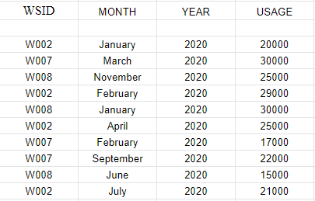
Sample Data
WaterUsage Table

Slide 90
Creation of SanitationSystems Table
create table SanitationSystems
(
SSID varchar2(4) not null,
SStatus varchar2(15),
SEstimation number(10),
Pincode number(6),
constraint pk_SSID primary key (SSID),
constraint fk_SPincode FOREIGN KEY(Pincode) REFERENCES Location(Pincode)
)

Slide 91
Insertion Of SanitationSystemsTable
insert into SanitationSystems values('S001','Constructed',2100000,641105);
insert into SanitationSystems values('S002','Constructed',2000000,641041);
insert into SanitationSystems values('S005','Constructed',2000000,641605);
insert into SanitationSystems values('S006','Constructed',1700000,609503);
insert into SanitationSystems values('S009','Constructed',2300000,626126);

Slide 92
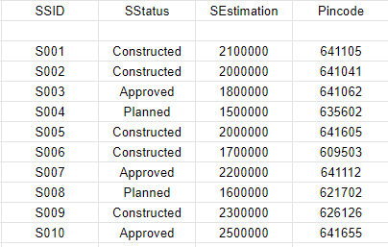
Sample Data
SanitationSystems Table

Slide 93
Creation of Families Table
create table Families
(
FID varchar2(6) not null,
Persons number(2),
FHead varchar2(10),
Consumption number(5),
FContact number(10),
Pincode number(6),
constraint pk_FID primary key (FID),
constraint fk_FPincode FOREIGN KEY(Pincode) REFERENCES Location(Pincode)
)

Slide 94
Insertion Of Families Table
insert into Families values('F00001',4,'Ashwin',7500,7358973592,641105);
insert into Families values('F00002',3,'Venkat',5000,9391357915,641041);
insert into Families values('F00003',8,'Sriram',15000,9989763459,641062);
insert into Families values('F00004',6,'Chandu',10000,9676313275,635602);
insert into Families values('F00005',2,'Senthil',1500,7702184949,641605);
insert into Families values('F00006',7,'Ganesh',13500,8985717469,609503);
insert into Families values('F00007',4,'Akash',75000,9490384823,641112);
insert into Families values('F00008',3,'RamaRao',5000,8356983593,621702);
insert into Families values('F00009',5,'Saravan',9000,9441754535,626126);
insert into Families values('F00010',6,'Manoj',10000,8886433659,641655);

Slide 95
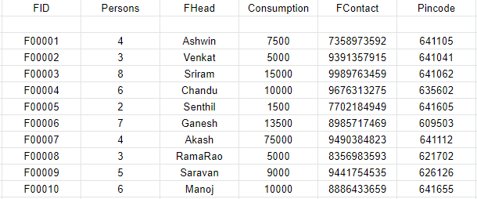
Sample Data
Families Table

Slide 96
Creation of Donations Table
create table Donations
(
TransactionID varchar2(6) not null,
AccountNumber number(15),
Amount number(10,2),
DContact number(10),
DDate varchar2(25),
constraint pk_TransactionID primary key (TransactionID)
)

Slide 97
Insertion Of DonationsTable
insert into Donations values('T00001',123456789009123,1500,9652836888,'2020-01-22');
insert into Donations values('T00002',123456769009224,1000,9676313275,'2020-04-11');
insert into Donations values('T00003',123565678432156,500,8985546789,'2020-01-02');
insert into Donations values('T00004',567895432167889,750,9678654329,'2020-05-07');
insert into Donations values('T00005',123564567897656,2500,7702184949,'2020-07-03');
insert into Donations values('T00006',678954325689567,1900,9490384823,'2020-01-10');
insert into Donations values('T00007',789456345678956,5000,9989654329,'2020-06-06');
insert into Donations values('T00008',657894325678976,35000,9989442189,'2020-05-15');
insert into Donations values('T00009',456789543267798,550,6302856789,'2020-02-21');
insert into Donations values('T00010',345678934523678,300,7302184965,'2020-03-20');

Slide 98
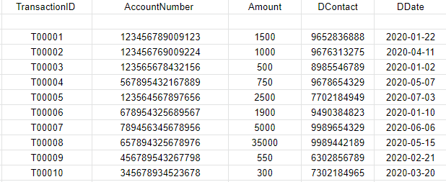
Sample Data
Donations Table

Slide 99
Creation of Expenditure Table
create table Expenditure (
ExpenseID varchar2(6) not null,
EDate varchar2(25),
EmpID varchar2(4),
WSID varchar2(4),
SSID varchar2(4),
EAmount number(10,2),
constraint pk_ExpenseID primary key (ExpenseID),
constraint fk_EmpID FOREIGN KEY(EmpID) REFERENCES Employee(EmpID),
constraint fk_EWSID FOREIGN KEY(WSID) REFERENCES WaterSource(WSID),
constraint fk_SSID FOREIGN KEY(SSID) REFERENCES SanitationSystems(SSID) )

Slide 100
Insertion Of ExpenditureTable
insert into Expenditure values('E00001','2020-01-01','E004','W003','NULL',15000);
insert into Expenditure values('E00002','2020-03-06','E009','W007','NULL',20000);
insert into Expenditure values('E00003','2020-04-09','E005','NULL','S006',10000);
insert into Expenditure values('E00004','2020-02-14','E001','NULL','S003',25000);
insert into Expenditure values('E00005','2020-01-25','E002','W004','NULL',5000);
insert into Expenditure values('E00006','2020-05-09','E003','NULL','S005',7500);
insert into Expenditure values('E00007','2020-04-16','E007','NULL','S002',12500);
insert into Expenditure values('E00009','2020-08-15','E004','W002','NULL',15000);
insert into Expenditure values('E00010','2020-05-15','E008','NULL','S008',12000);

Slide 101
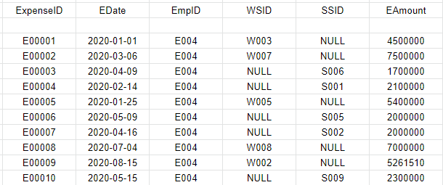
Sample Data
Expenditure Table

Slide 102
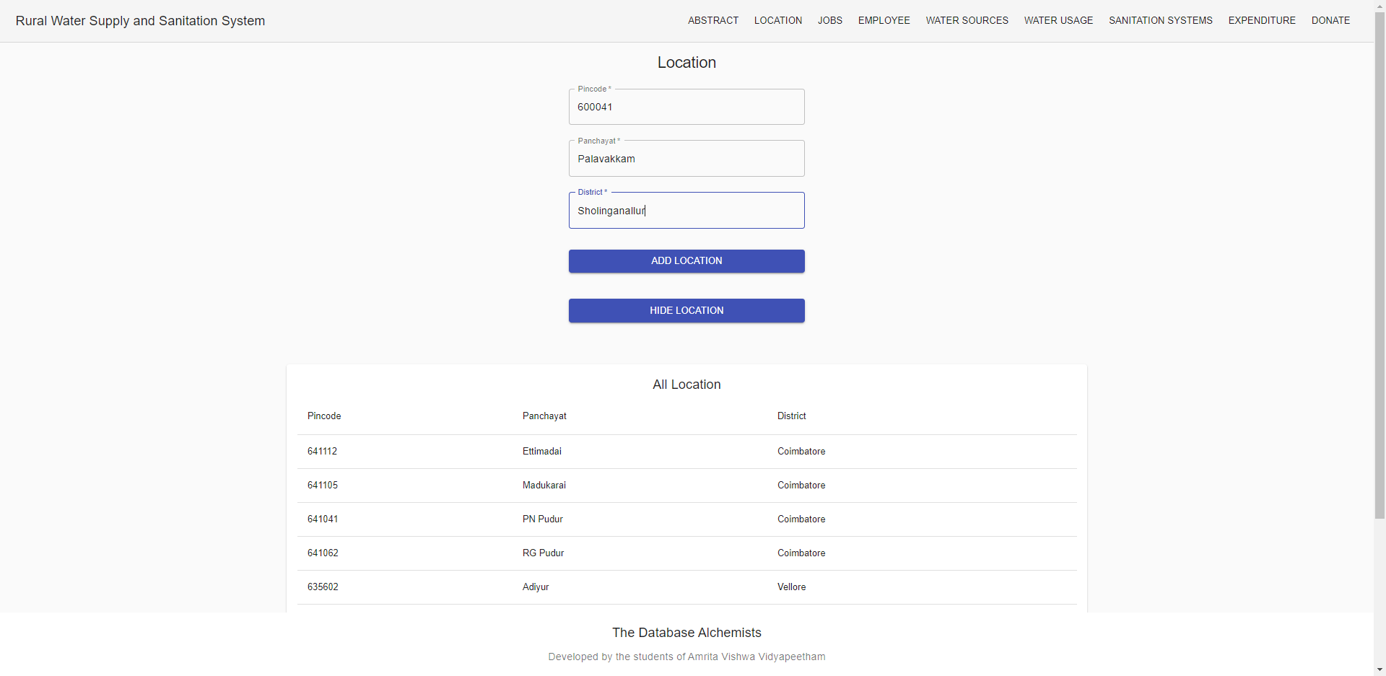
User Interface Screens
Location Table:

Slide 103
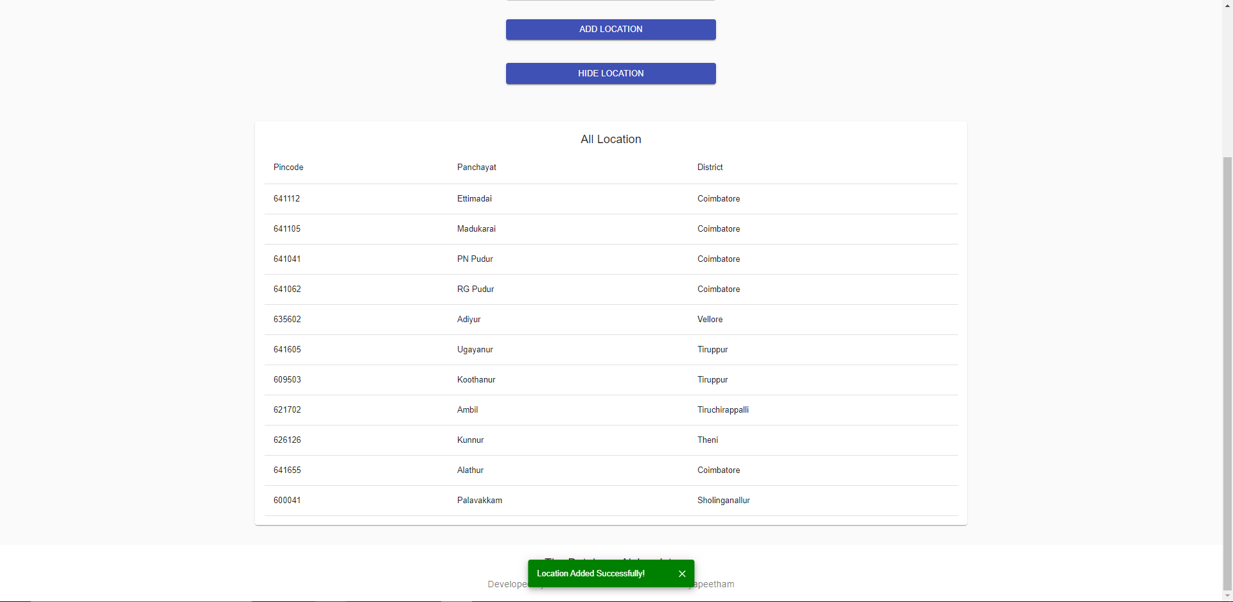
User Interface Screens
Location Table:

Slide 104
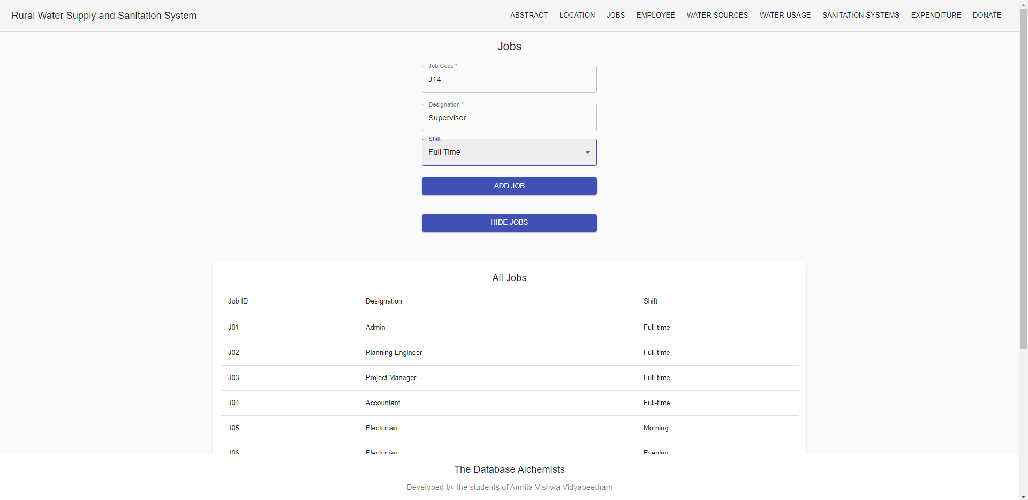
User Interface Screens
Jobs Table:

Slide 105
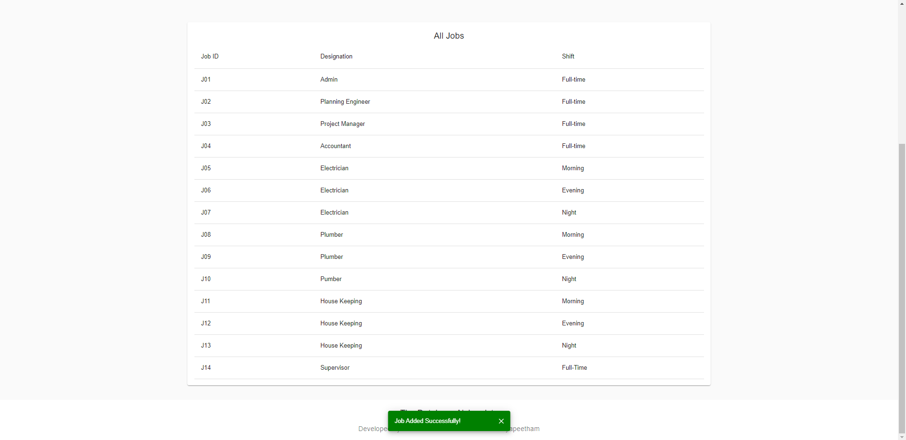
User Interface Screens
Jobs Table:

Slide 106
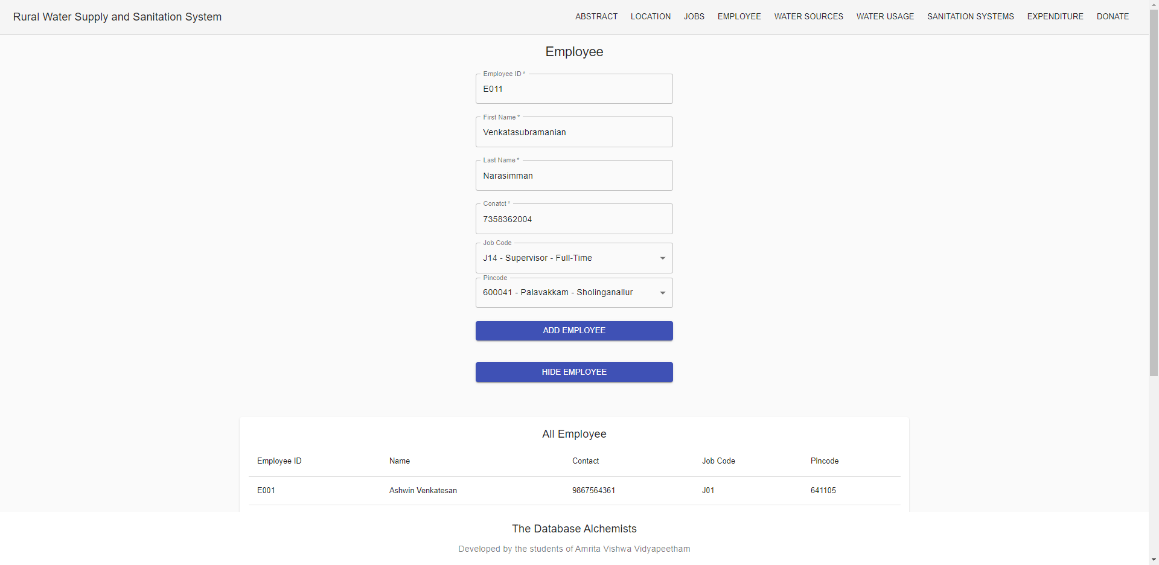
User Interface Screens
Employee Table:

Slide 107
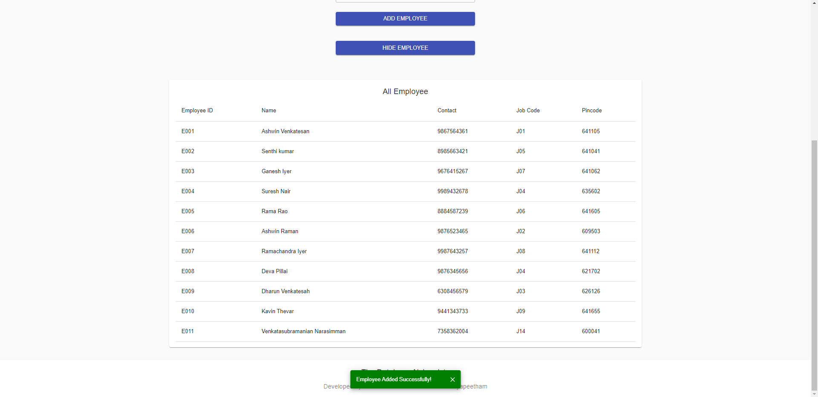
User Interface Screens
Employee Table:

Slide 108
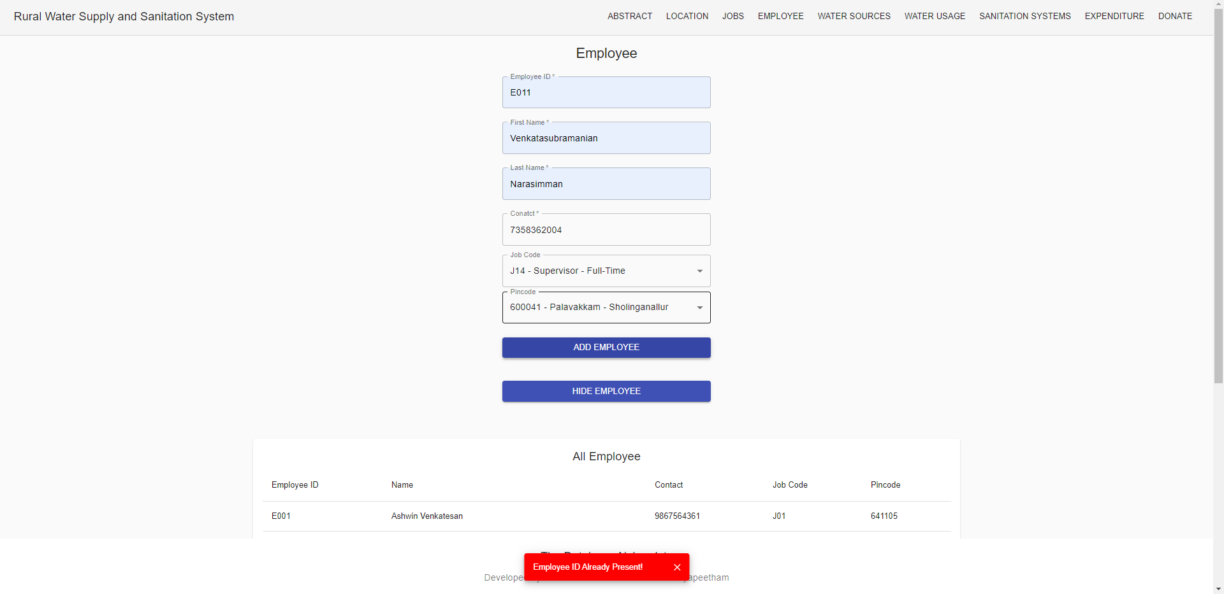
User Interface Screens
Employee Table (Validation of PK):

Slide 109
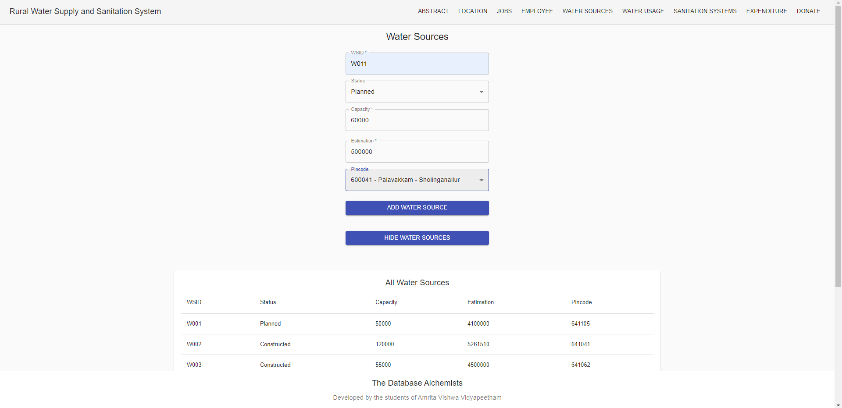
User Interface Screens
Water Source Table:

Slide 110
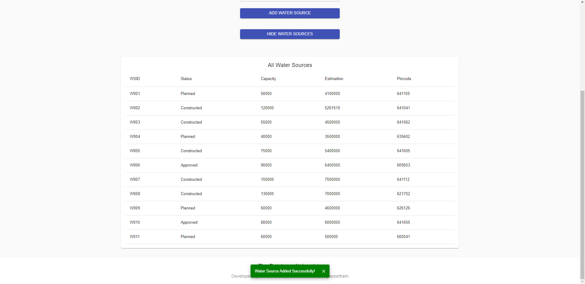
User Interface Screens
Water Source Table:

Slide 111
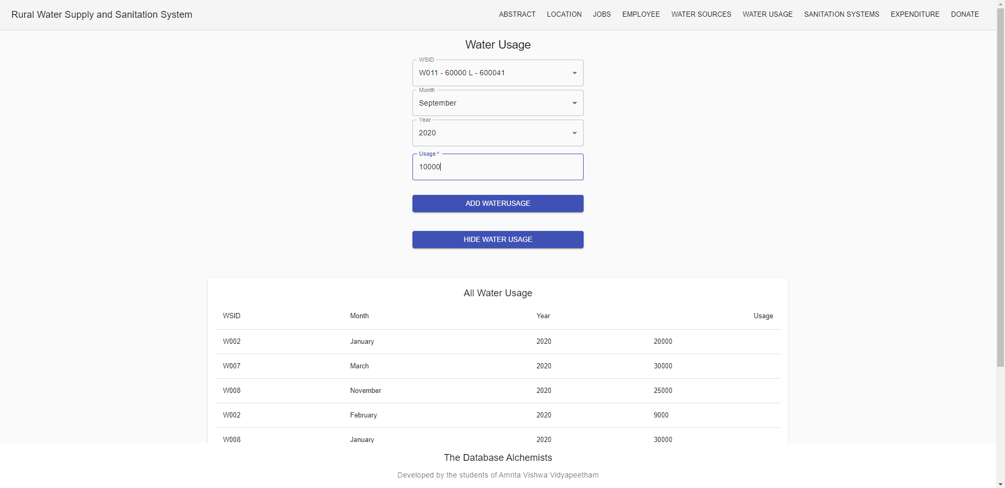
User Interface Screens
Water Usage Table:

Slide 112
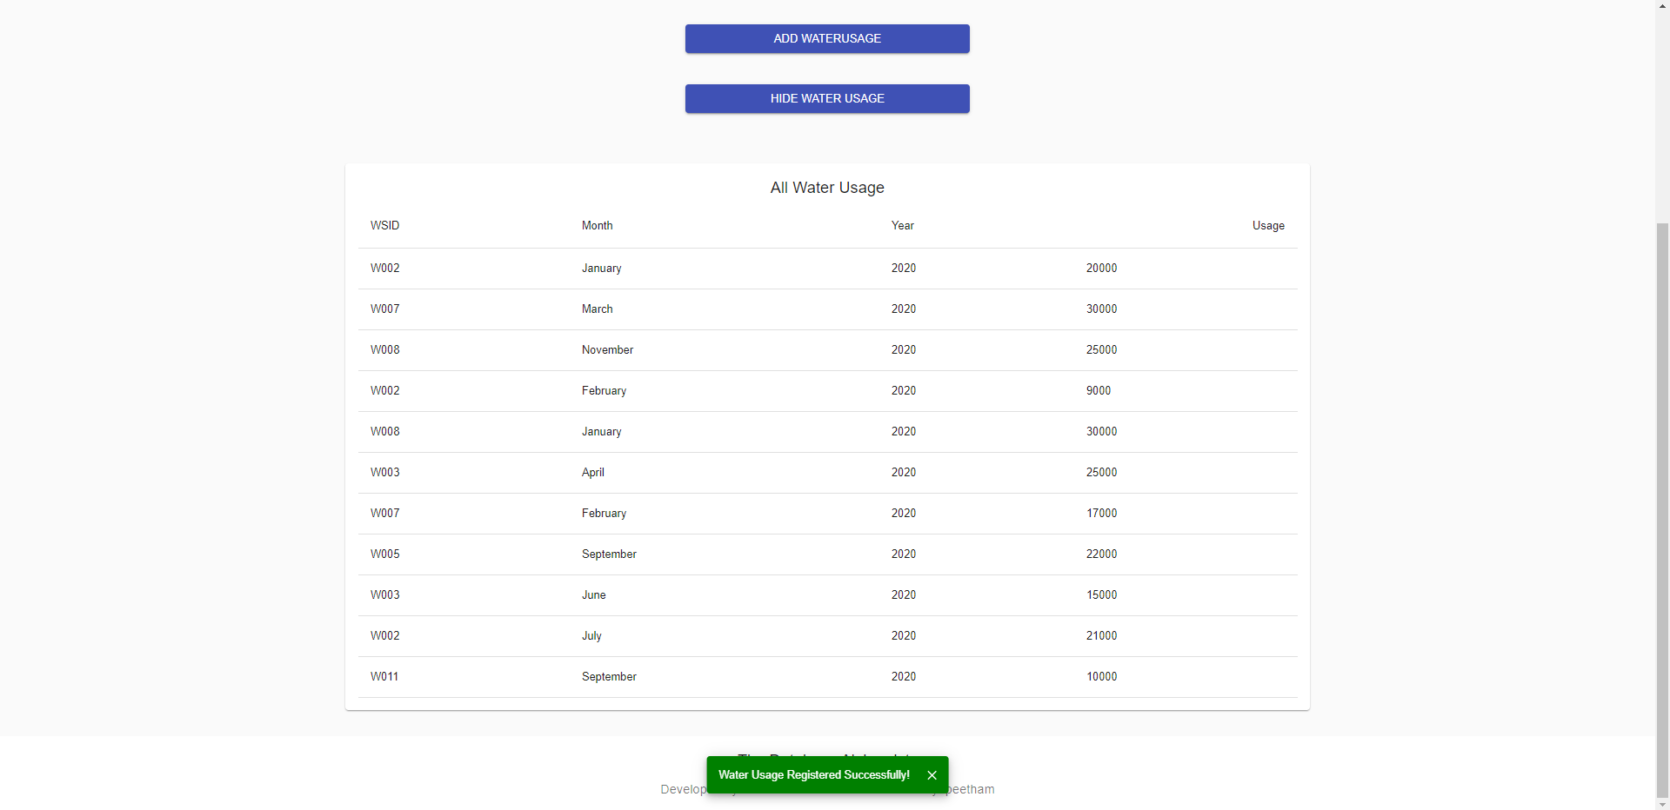
User Interface Screens
Water Usage Table:

Slide 113
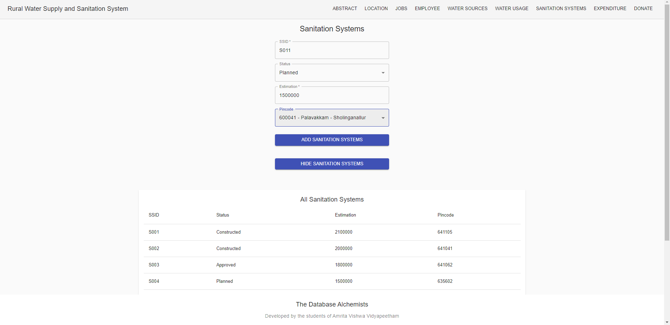
User Interface Screens
Sanitation Systems Table:

Slide 114
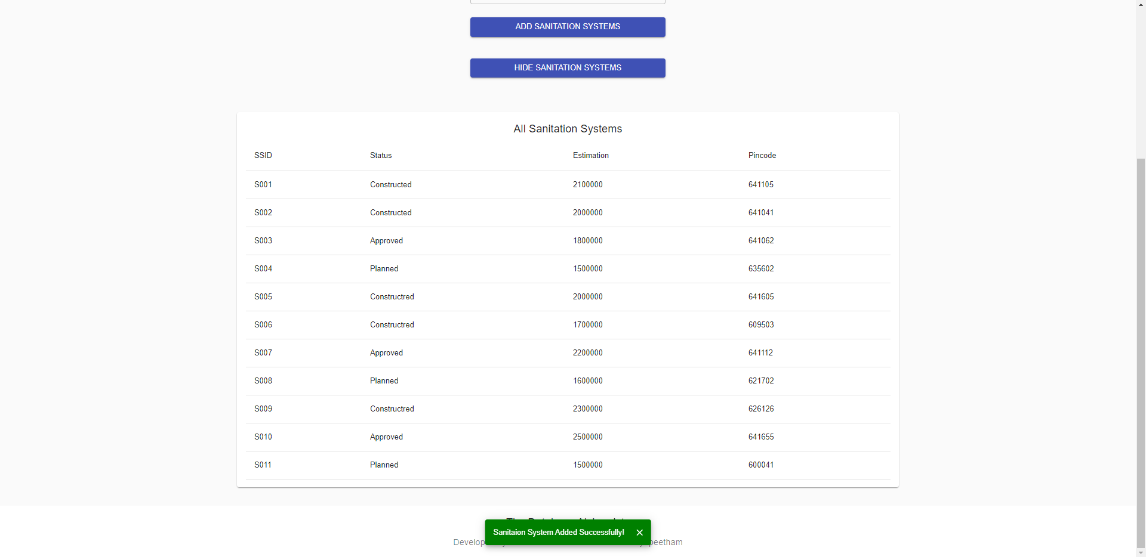
User Interface Screens
Sanitation Systems Table:

Slide 115
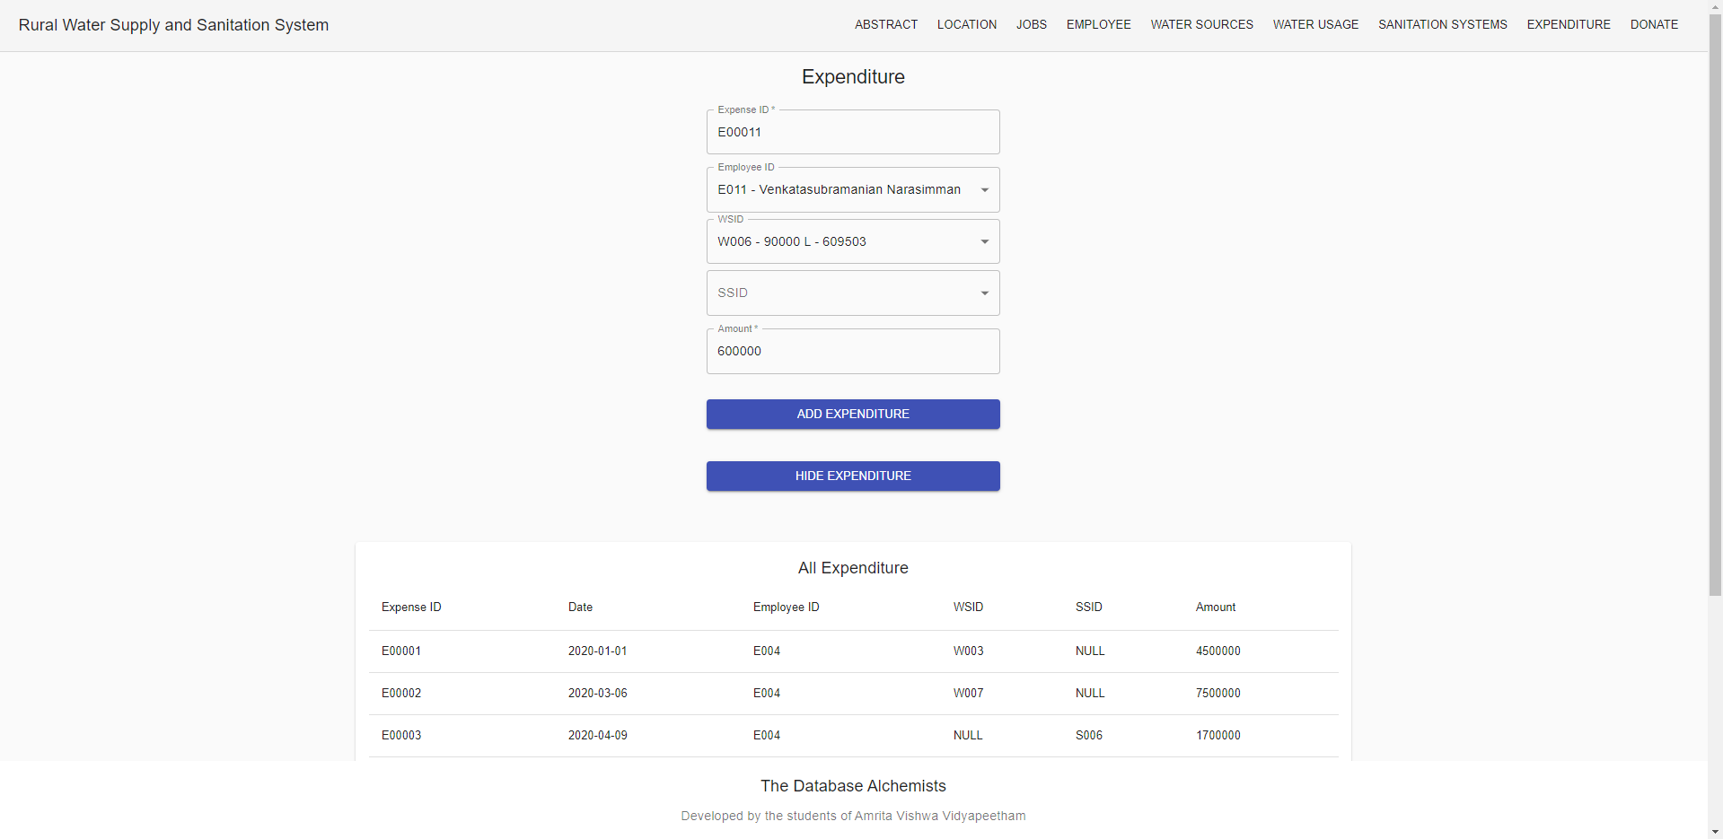
User Interface Screens
Expenditure Table:

Slide 116
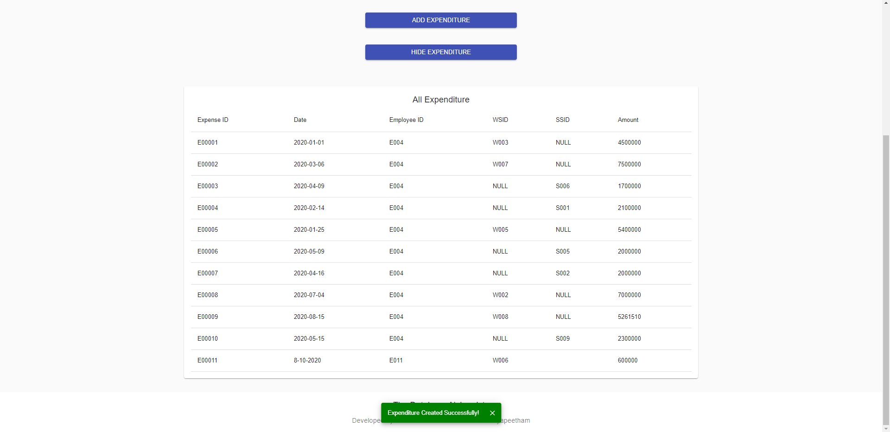
User Interface Screens
Expenditure Table:

Slide 117
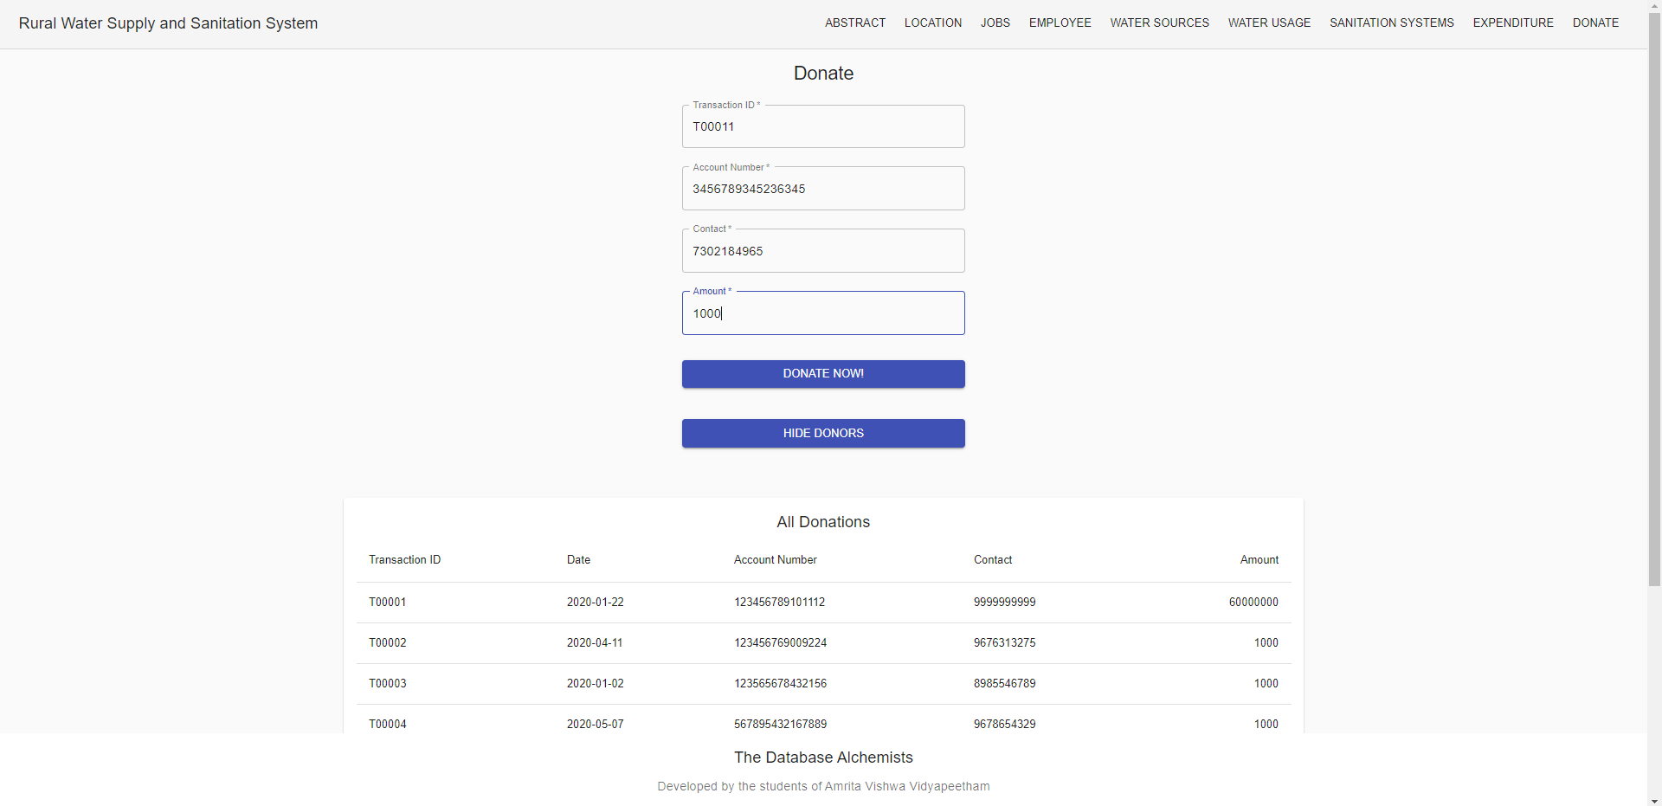
User Interface Screens
Donations Table:

Slide 118
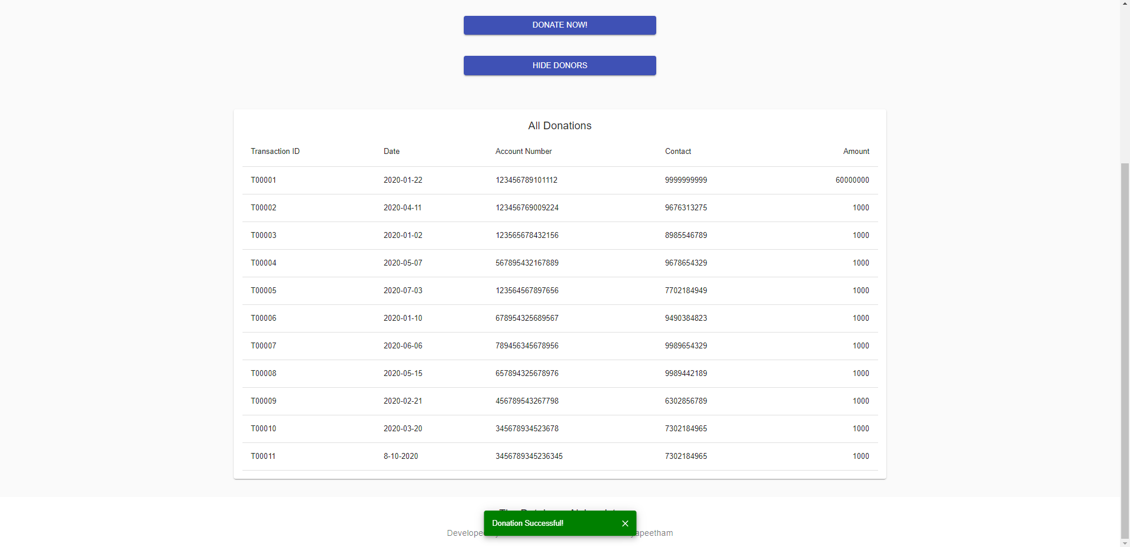
User Interface Screens
Donations Table:

Slide 119
Connectivity Code
const mysql = require('mysql');
const connection = mysql.createConnection({
host: "localhost",
user: "root",
password: "root", port: 3306
});
module.exports = connection;

Slide 120
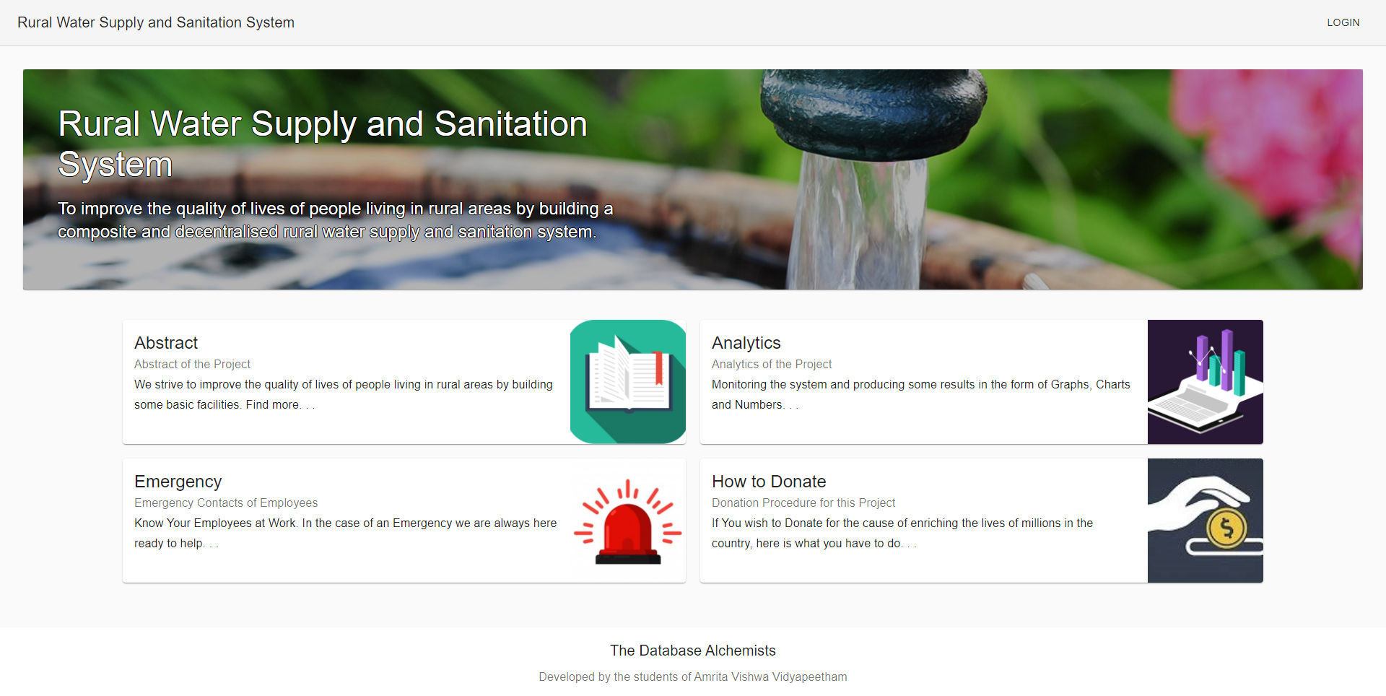
UI Screen Home Page

Slide 121
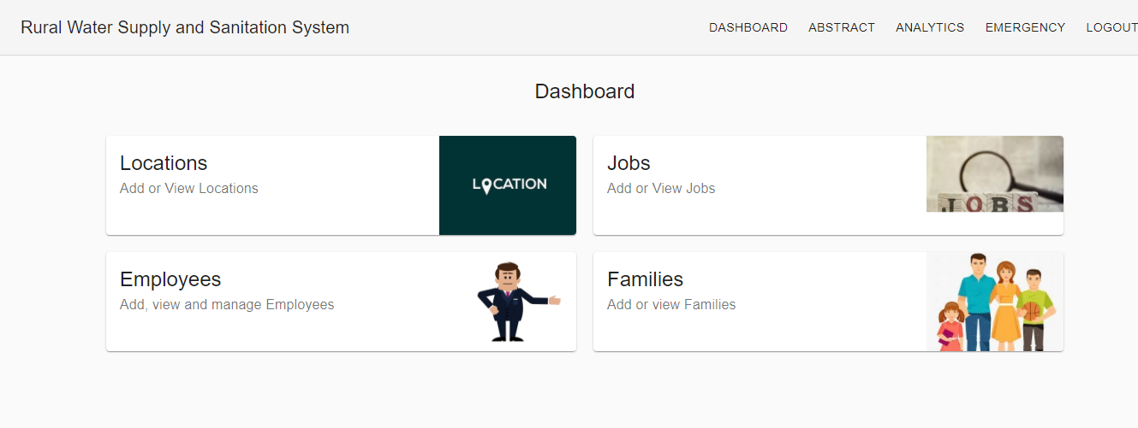
UI Screen – Admin Dashboard

Slide 122
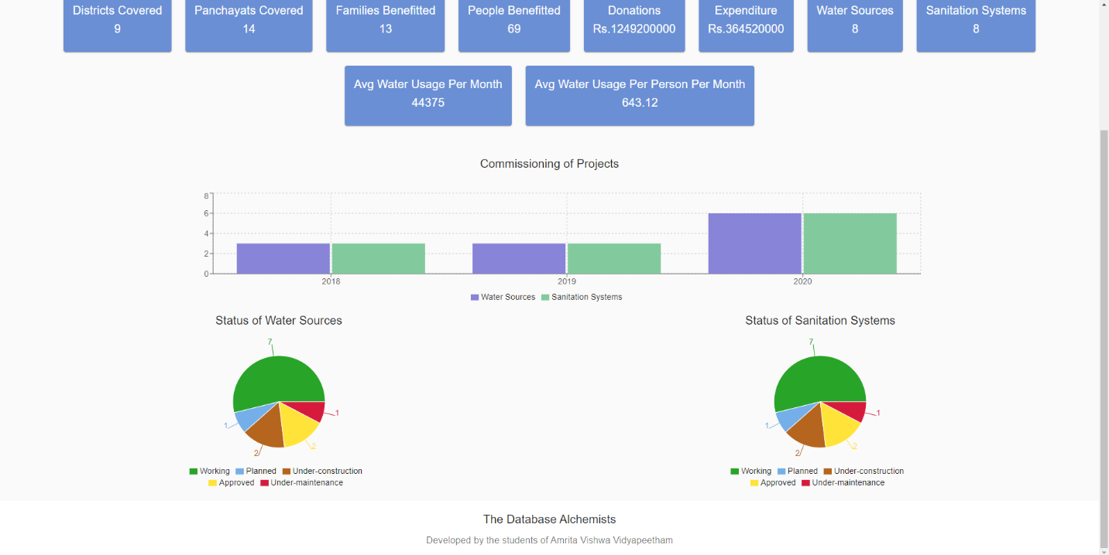
UI Screen – Analytics (Report)

Slide 123
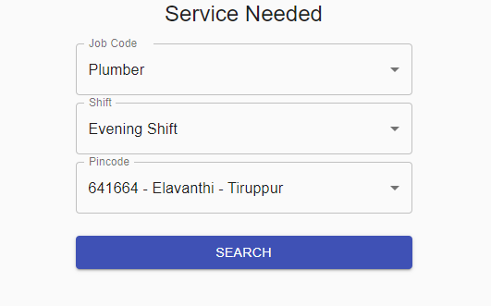
UI Screen – Emergency Service Request

Slide 124
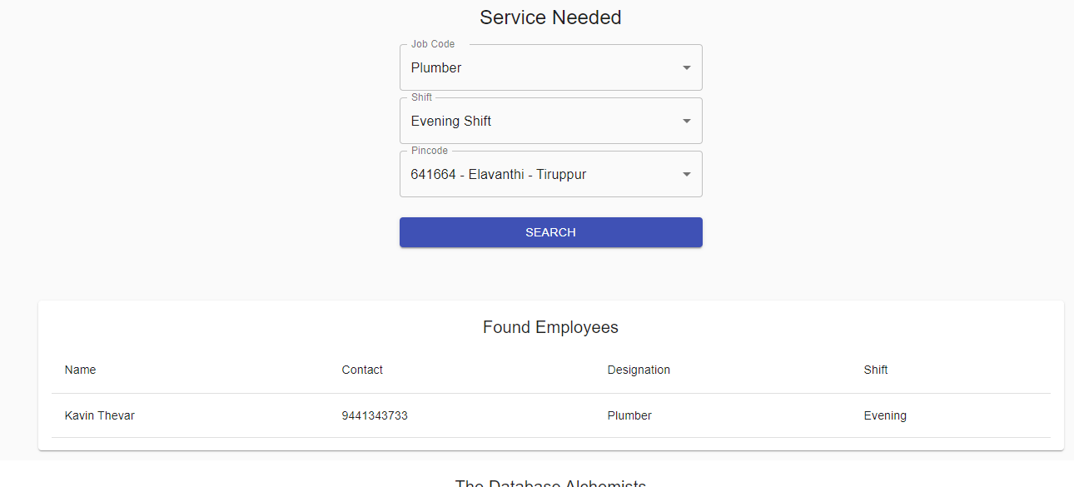
UI Screen – Emergency Output

Slide 125
Conclusion
The goal of the project which was to develop a monitoring system for a Rural Water Supply and Sanitation System was met and the data collected from the model has been used to analyze various parameters and provide insights for the organization undertaking the project work in real life.

Slide 126
Reference
React Tutorial for Beginners - Programming with Mosh
Website: YouTube
Date of Visit: 01/10/2020 – 09/10/2020
URL: https://www.youtube.com/watch?v=Ke90Tje7VS0
Example Live Project - Kerala Rural Water Supply and Sanitation Agency
Website: jalanidhi.kerala.gov.in
Date of Visit: 07/09/2020 – 09/10/2020
URL: https://jalanidhi.kerala.gov.in/page/render/reference/Jalanidhi_Analytics

Slide 127
Thank You
Happy to Answer your Questions!

